Slide 1
A I R L I N E S A F E T Y
Executive Summary
Satish Agrawal
DSC 640

Slide 2
Overview
Airline has been one of the safest way to travel traditionally. Latest incidents and reports are suggesting air travel is not a safe way to travel anymore. there is a bunch of data and statistics being presented and compared with other modes of travel.
We have gathered and analyzed some of the available data and letting the data speak the truth in this presentation.

Slide 3
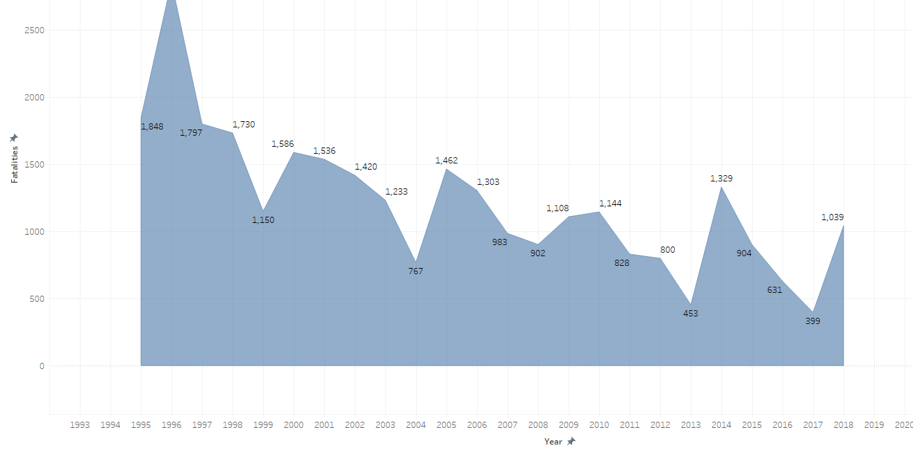
Fatalities over the years in Air travel
Overall trend shows decline in fatalities by air travel

Slide 4
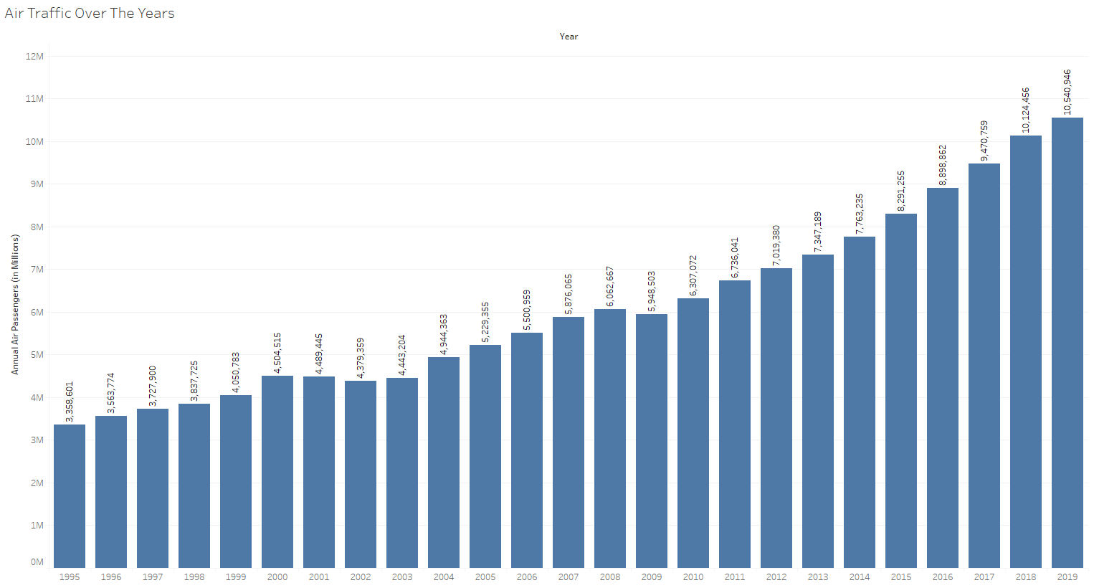
Air Traffic Over The Years
Increase in air traffic over the years

Slide 5
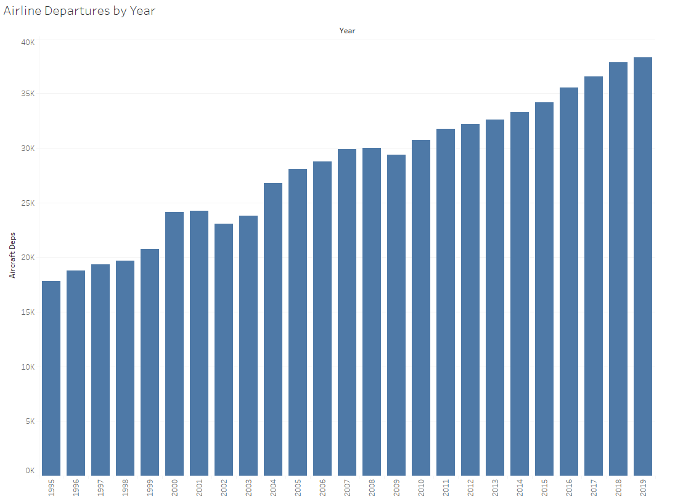
Airline Departures Over The Years
Number of flights have increased shows the increased use of air travel

Slide 6
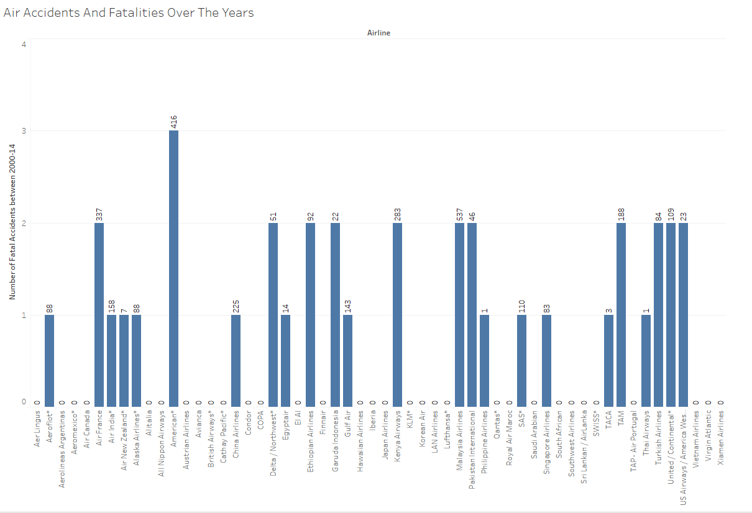
Air Accidents And Fatalities Over The Years

Slide 7
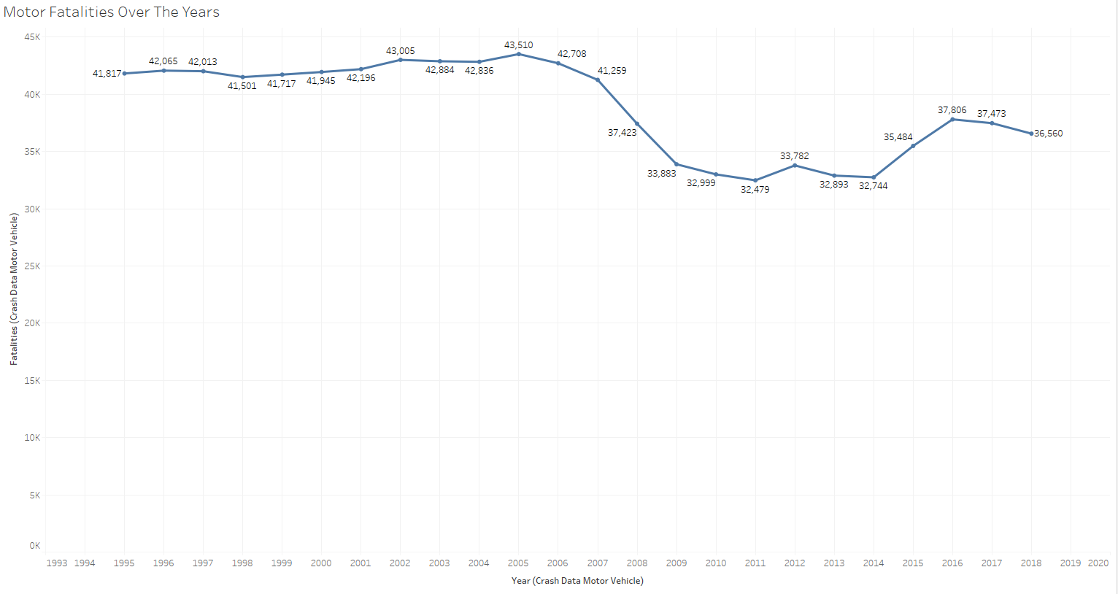
Motor Fatalities Over The Years

Slide 8
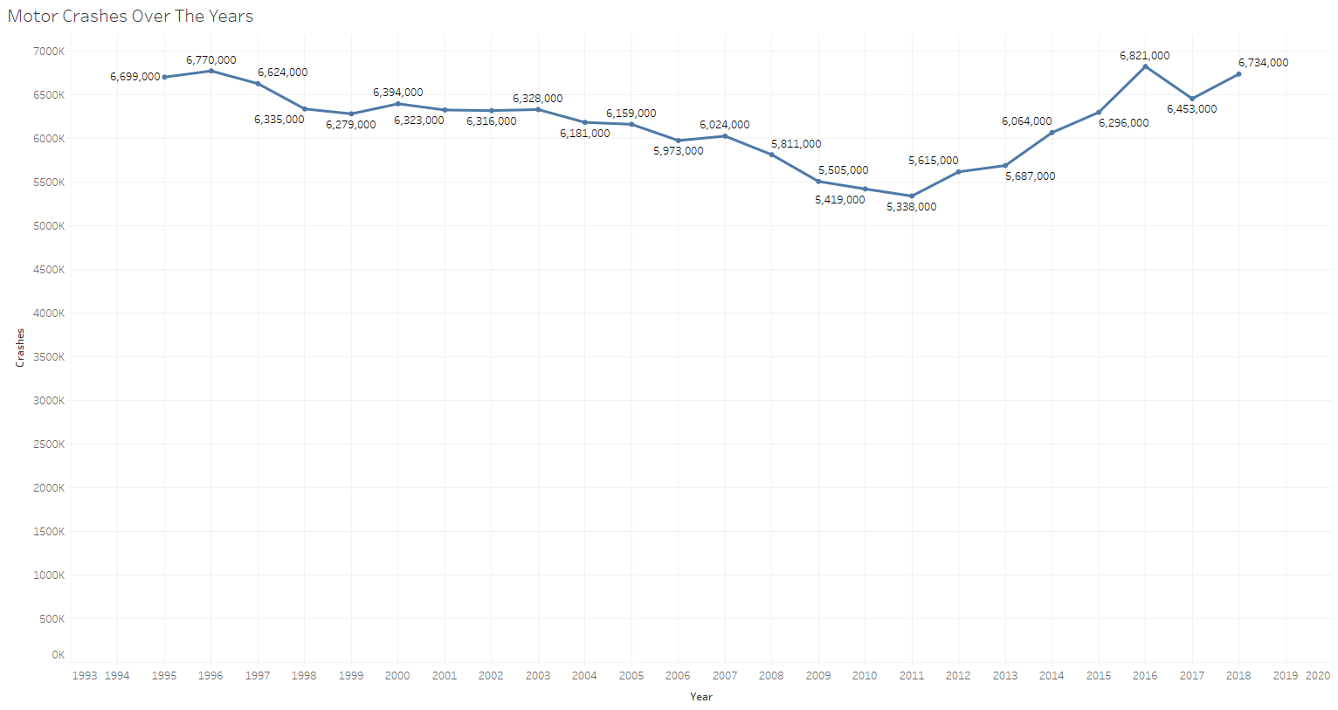
Motor Crashes Over The Years

Slide 9
Thank You

